Slide 1
Chicopee® Floorcare Launch
a brand of
May 2016

Slide 2
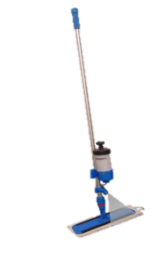
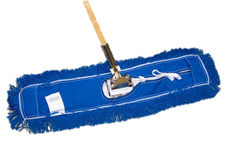
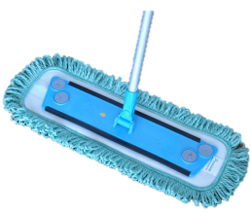
What is the opportunity?
Commercial (Hard Surface) Floorcare - $4.98BN
Traditional
String Mopping
NEW
Flat / Microfiber
Damp/Wet Mops
$1.02BN
Dry/Dust Mops
$618M
Damp / Wet
$1.02BN
Powered
Equipment
$2.28BN
Mop Equipment
$438M
Brooms Brushes
$615M
Non- Powered Equipment
$2.7BN
Dry / Dust $618MM
Increase in the realisable TAM with a shift to flat mopping
Change in hygiene habits and needs drives disposability
Global market is dominated by players without NW knowledge
Very Similar- Categorized Together
73% of Market
28% of Market
Market Shift

Slide 3
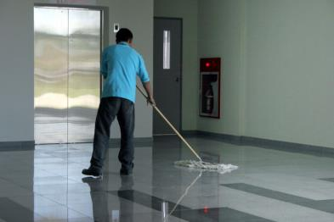
Why the need?
Dust and dirt build-up is inevitable on every kind of smooth floor or surface and is
Unattractive
Unhygienic
Triggers allergies
Creates health and safety problems
Traditional floor and surface cleaning cloths may contribute to the problem by
Transferring dirt and grime from one area to another
Returning from laundry still contaminated with bacteria
Electronic cleaners may not be suitable for cleaning during the day

Slide 4
2 Types of Floor Mopping
DRY
Wet
Also referred to as “DUST Mopping”
Always recommended to dry mop BEFORE wet mopping
Dry mopping collects the main dust and debris
This is important for 2 reasons
Dust is a breeding ground for bacteria, this combined with the moist conditions of wet mopping can increase bacteria growth
Wet mopping is often used for cleaning/disinfecting, if the surface is not clean beforehand the chemical cannot effectively dwell on the surface
Normally referred to as WET mopping
Accounts for about 25% of floor cleaning in time spent cleaning
But accounts for around 50% of spend on floor mops
Important criteria
Mop drag/glide – Wet mopping is hard work, mops should glide easily over the surface to reduce risk of RSI’s
The mop should clean as large an areas possible, 20m2 is the industry standard

Slide 5
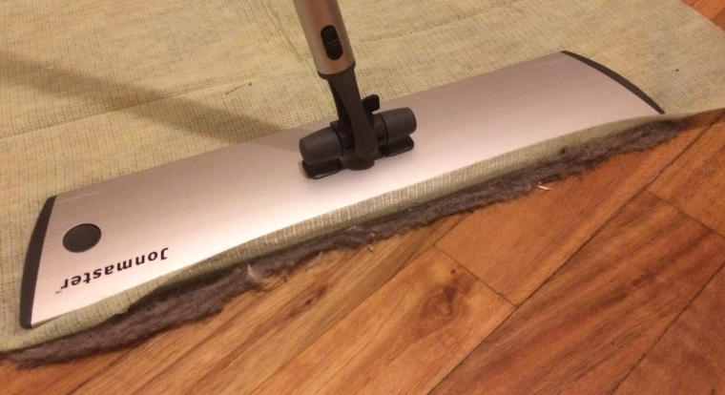
Dry Moping – Problems
Underutilised surface area of the fabric
Dust & dirt cannot ingress into the centre of the mop
This means a large cross section of the floor mop is not utilised
Build up of dust and debris
The high level of surface contact means that dirt and debris are stuck at the front of the mop
Dust & Dirt ae not trapped in the mop
Mop needs to be changed more frequently
Visually very poor, creates a bad impression
Underside of traditional flat mop
Front edge of flat mop

Slide 6
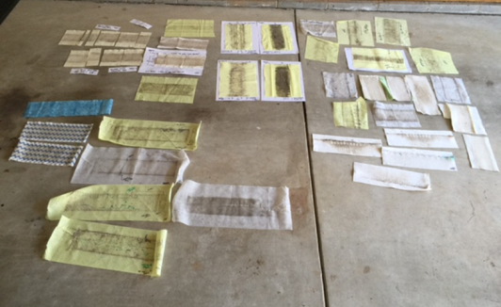
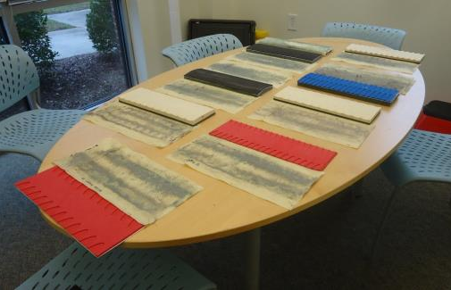
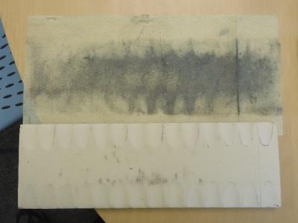
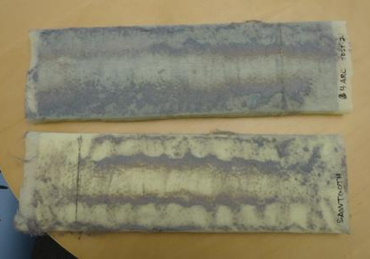
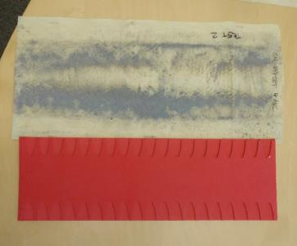
The right solution?
Testing, Testing, Testing!
Refinement and detailed testing

Slide 7
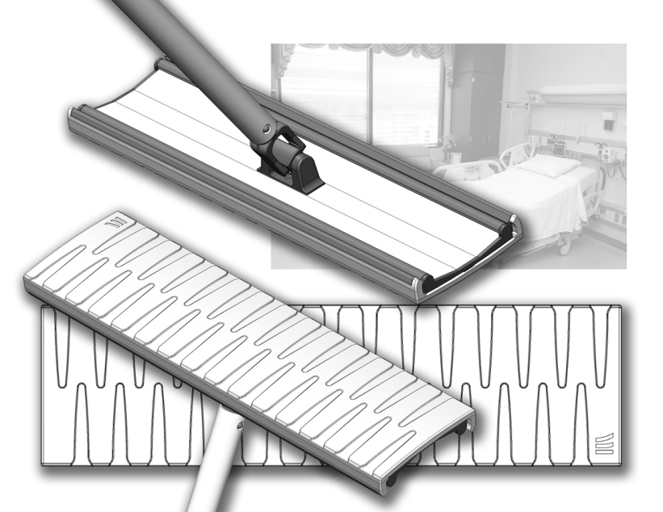
Final solution – Increased effectiveness
Increased dust pick up
Simple zip channel for mop attachment
Bumper at the edge of mop to reduce marks on walls
3.5’ angled mop head to allow dust & debris ingress
Channels on the mop to encourage dust & debris to the centre of the mop
Easy to clean & softer surface contact, for reduced feedback and vibration

Slide 8
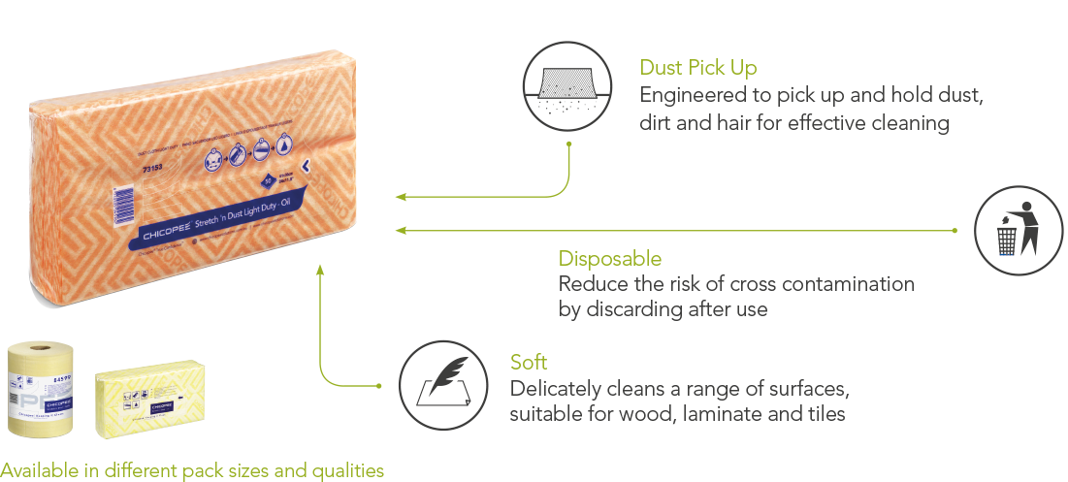
Dry Dust Mopping
Perfect for public areas & sites where machine washing is not possible
We have a range of Oil & Tack dry dusting products, as well as the Microfibre Economy and Light products which can both be used wet or dry

Slide 9
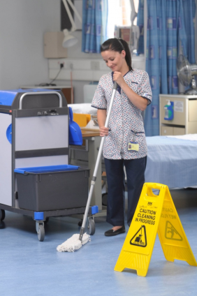
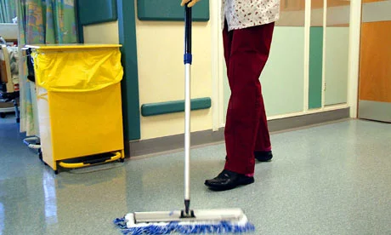
Wet Mopping - Problems
Risk of cross contamination
In healthcare settings its is prescribed that 1 mop can only clean 1 area or room
This means that the product is not used for a long period, but still needs to provide and effective clean
Limited Sq mtrs possible with x1 mop
Outside of high risk areas the problem is physically how much liquid a wet/damp mop can hold in
The market leading products can achieve upto 25 Sq mtrs maximum
Distribution of cleaning liquids varies widely from start to end
Dwell times cannot there be guaranteed
Single Room Cleaning
Large public areas

Slide 10
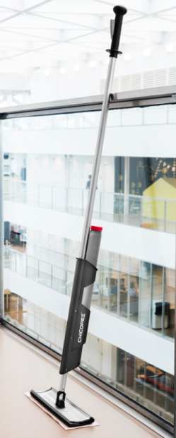
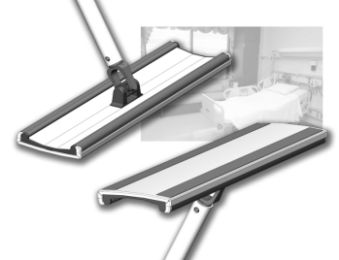
Chicopee Fluid Mop System
The ONLY Fluid mop system designed for short term use disposable microfibre mops!
Why does this matter?
Many sectors are now switching to disposable microfibre products for floor mopping, but all other fluid mopping tools are designed for washable microfibe pads
Why is that a problem?
Disposable microfibre products are designed to be much lighter and more “disposable” than traditional microfibre washable pads. This can be achieved by carry the fluid in the mopping tool, rather than saturating the mop itself
The problem with this is that disposable microfibre mops feel very thin and flat, and when mopping don’t provide cushioning, so it can feel uncomfortable for the user and not be as effective
How is the Chicopee system different?
Our Chicopee® Fluid mopping system is designed ONLY for disposable microfibre mops, therefore we engineered a soft foam base to provide cushioning and created a 3.5’ angle on the base of the mop to allow dirt and debris into the centre of the disposable mop

Slide 11
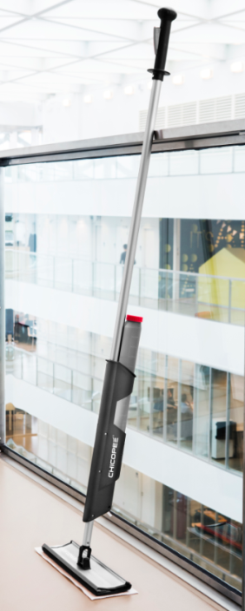
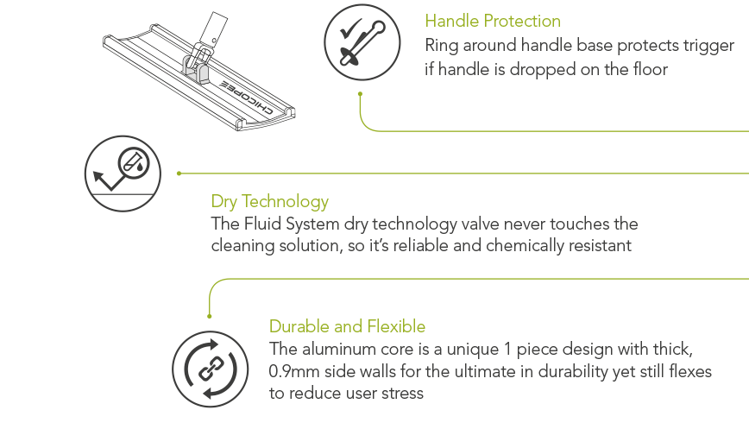
Ergonomic Cleaning Tools
Removable reservoir for easy and fast refilling
Bumper at the edge of mop to reduce marks on walls
Easy to clean & replaceable mop head for highest hygiene standards
Replaceable caps for the fluid reservoir for easy colour coding

Slide 12
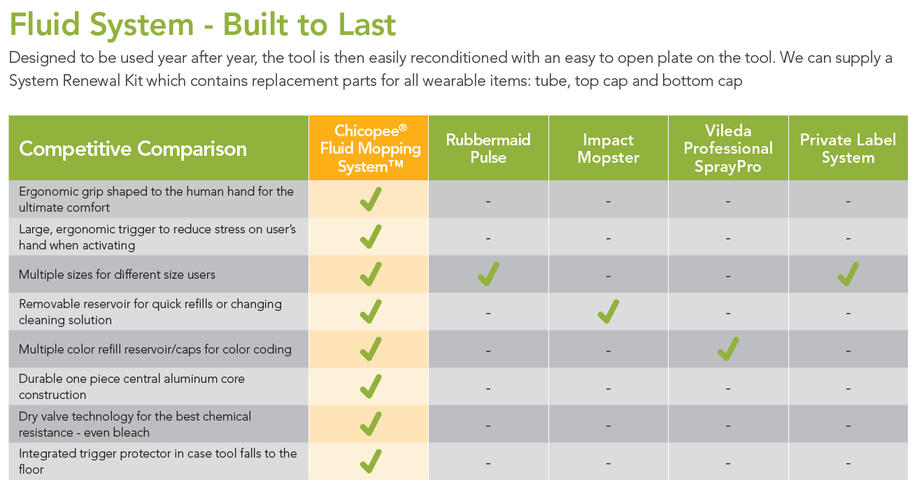
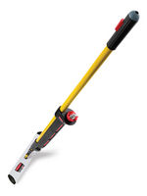
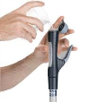
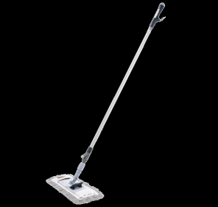
Chicopee Fluid System – Built to last

Slide 13
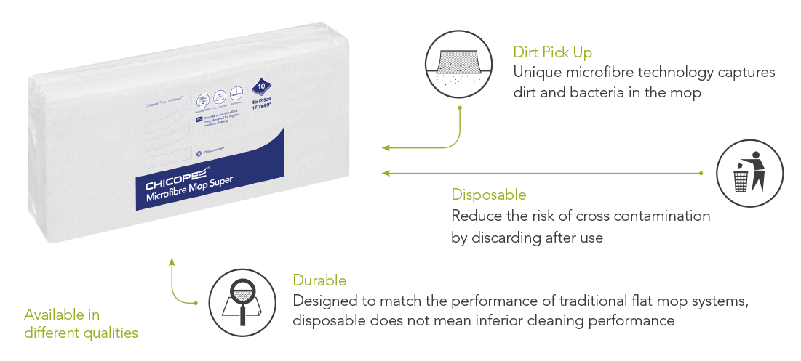
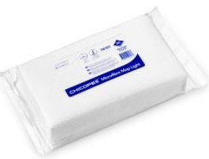
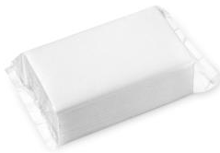
Hygienic Wet Mopping
Short term use microﬁbre mops, for disposal after use

Slide 14
Chicopee® Microfibre Mop Super
Premium 25m2, delivered dry for pre impregnation on site
Matches traditional wovens for cleaning area
Can be used as a absorbent pad for spillages and drying
Chicopee® Microfibre Mop Light
Designed for use with the Fluid mopping system
Deep channels for capturing dirt and debris, perforated pack
75m2 cleaning ability
Chicopee® Microfibre Mop Economy
Designed for use with the Fluid mopping system
Lightweight product for high hygiene areas, perforated pack
50m2 cleaning ability

Slide 15
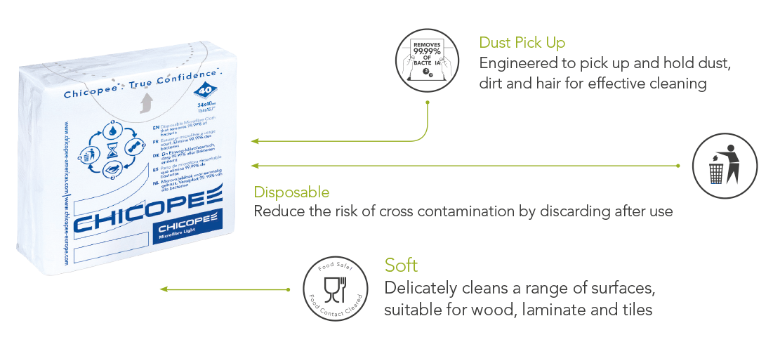
Surface Cleaning - Microfibre Light
Superior cleaning with 99.99% microbe removal

Slide 16
Chicopee Dusting Mop - Extendable
Extendable handle for flexibility to change size depending on height of user
Foam mop head with recessed channels and a 3.5’ angle for improved dust and dirt pick up and retention
Innovative new collar lock for color coding.
Additional color code rings packed with each handle for HACCP

Slide 18
Appendix
a brand of
Proof pictures

Slide 19
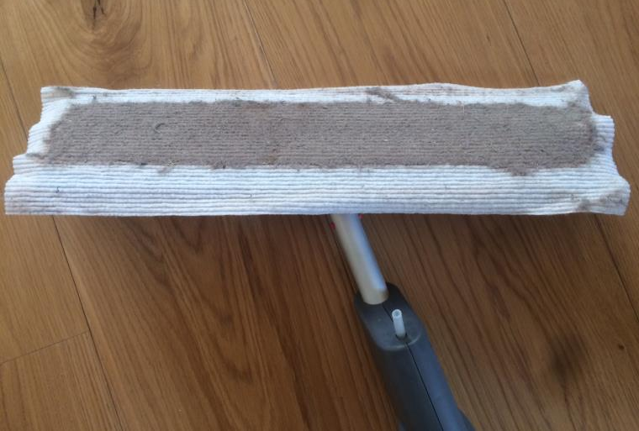
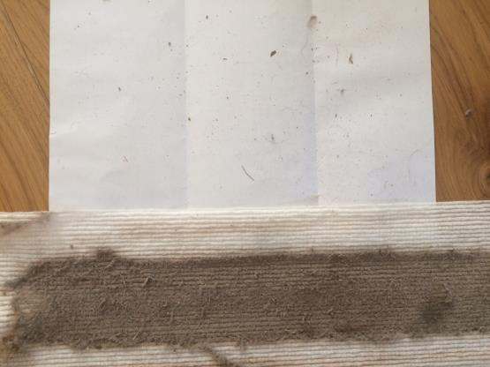
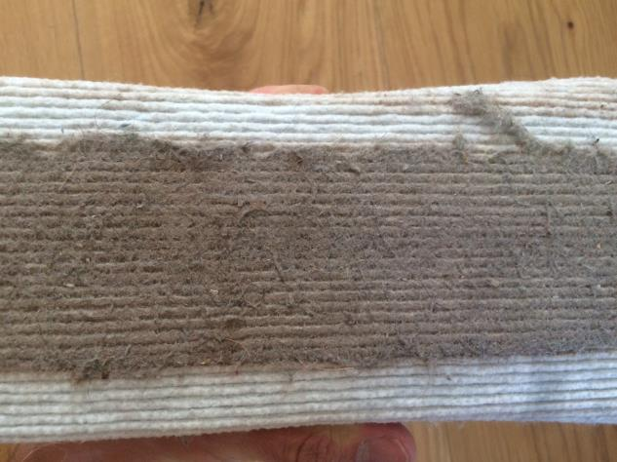
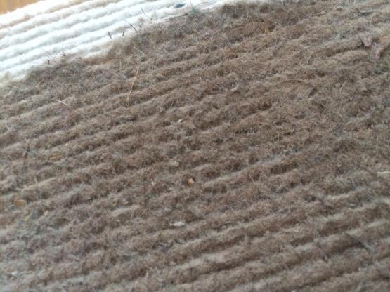
Chicopee® Microfibre Floor Mop - Light
Blue dotted line shows the frame outline
Debris shaken gently from the dry mop after dusting
As you can see small debris, stones, hair and dust have been captured and locked into the channels of the mop
Also you can see from the blue lines above the front and rear edge have not become “blocked” allowing you to mop much further with 1 sheet than traditional flat systems

Slide 20
