Slide 1
Chicopee® True confidence.
Chicopee Microfibre Light

Slide 2
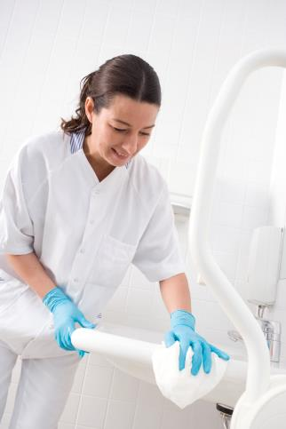
Chicopee Microfibre Light - Cloth
Unique 100% microfibre cloth designed for short term use
Removes 99.99%* Bacteria from the surface
* Externally certified to officially documented test methods to produce a 4 log removal of S.aureus and E.Coli from a stainless steel surface
NEW!

Slide 3
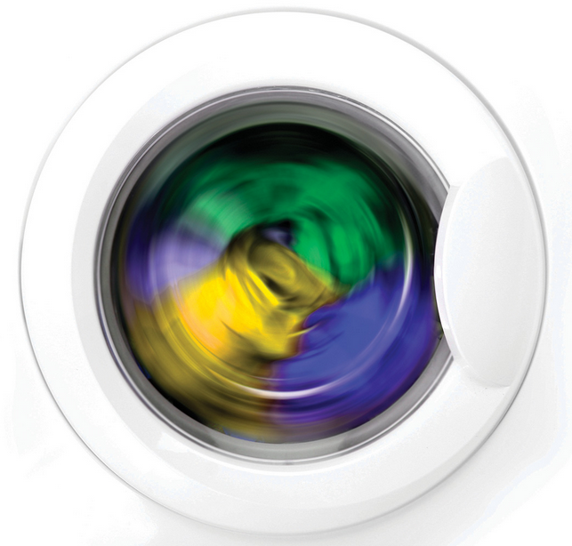
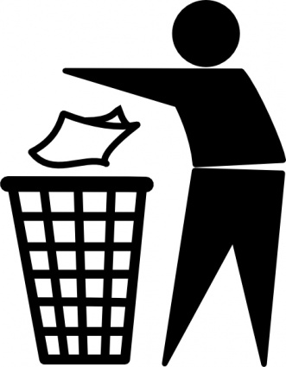
Challenges faced today
One of the most challenging aspects of patient care is keeping important areas of a healthcare facility clean. No mission is more important than ensuring that a patient is not exposed to needless health dangers while in the care of the facility
The American Journal of Infection Control study found that 93% of tested laundered towels used to clean hospital rooms contained bacteria that could result in healthcare-associated infections (HAIs). Typical laundering practices were insufficient for removing potentially harmful bacteria from reusable cloth and microfibre towels commonly used to clean hospital rooms

Slide 4
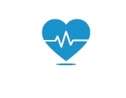
Hygiene problems in healthcare
Laundering practices are insufficient for removing potentially harmful bacteria from reusable cloth and microfiber towels
Proper cleaning practices in hospitals play a critical role in reducing the spread of bacteria that could cause HAIs and are especially important in the healthcare setting where patients with weakened immune systems may have a harder time fighting off germs
Many manufacturers of healthcare items and equipment have widely varying recommendations for cleaning. This arises from the lack of clinically grounded standards for the testing of commonly used cleaning products
HAI’s have become a significant problem in Europe with an estimated 4 million cases reported annually, with 20% seen as preventable.
* http://www.who.int/gpsc/country_work/gpsc_ccisc_fact_sheet_en.pdf

Slide 5
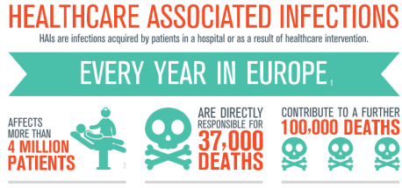
Value of the hygiene problems in healthcare
1
In Europe alone, 37.000 people die every year because of health care acquired infections. Inadequate hygiene is one of the main reasons.*
2
It is estimated that 20% of HAI’s are preventable with thorough cleaning protocol
Effective cleaning and simple procedures risk are critical in developing this protocol
3
Annual indirect financial losses due to health care associated infections (HAI’s) are significant They are estimated at €7 billion per year in Europe.*
In Europe alone HAI’s cause 16 million extra days in hospital. On average a person that acquires a HAI stays 4 extra days in the hospital
4
* http://www.who.int/gpsc/country_work/gpsc_ccisc_fact_sheet_en.pdf

Slide 6
Why short term use Microfibre?
1
Externally tested to remove 99.99%* bacteria from the surface through mechanical cleaning
93% of laundered microfibre cloths still contained bacteria, like E.coli, after laundering**
2
3
Studies found that Staphylococcus (MRSA) can survive for 19-21 days in traditional cloths**
4
Traditional cloths transferred up to 32%˟ of bacteria collected, Microfibre transferred 0%!
Wiping Direction
Microbes
Residue/Streak
Chicopee Microfibre Light
Traditional Cloth
*Biolab tests UK, Dr A. Summerfield, Dr Richard Hastings, June 2014
**Laura Y. Sifuentes PhD et al, American Journal of Infection Control 41 (2013) 912-5
˟Scott E, Bloomfield SF. The survival and transfer of microbial contamination via cloths, hand and utensils. J. Appl. Bacteriol. 1990;68:271-8
Notes:
Staphylococcal infections are a group of infections caused by the bacterium Staphylococcus. You may have heard them referred to as "staph infections".
Staph bacteria can cause a wide range of infections, from relatively minor skin infections such as boils, to more serious infections of the blood, lungs and heart.
There are many types of Staphylococci, but most infections are caused by a group called Staphylococcus aureus.
This group of bacteria includes meticillin-resistant Staphylococcus aureus (MRSA), which is resistant to certain antibiotics that are commonly used for staph infections, such as flucloxacilli
http://www.nhs.uk/conditions/staphylococcal-infections/pages/introduction.aspx

Slide 7
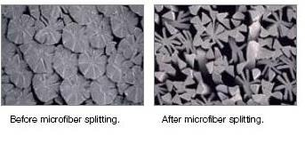
Explaining the microfibre
More Fibers per m2 = much greater surface area to clean
We split the fibres by high a pressure water system in our production process
Standard microfibre is measured at 0,7 – 1,0 decitex
The Chicopee microfiber cloth light is 0,1375 decitex
This is 80% finer than standard microfibre

Slide 8
The mechanical cleaning effect
Instead of detergent or chemicals, we rely on millions more “Micro”fibers that can sweep dirt away. The fibers are syntehtic and many of them attach themselves to each dirt speck
Working as a team, many fibers apply powerful enough forces to dislodge the dirt (loosened with a small amount of water, from the damp cloth) and carry it away, leaving the surface naturally free of 99.99% of microbes
The dirt stays locked inside the cloth's fibers until you wash it in hot water, which makes the fibers uncurl slightly and release their microbe content

Slide 9
Solution: Chicopee microfibre cloth – light
1
Superior cleaning performance by the unique splittable 100% microfibre structure – removes 99,99% of the bacteria
Removes the need to launder cloths, therefore saves time and improves hygiene practices
2
Eliminates the risk of cross contamination and reduces HAI’s and CAI’s
3
Unique how-to-use printed on the cloth
4

Slide 10
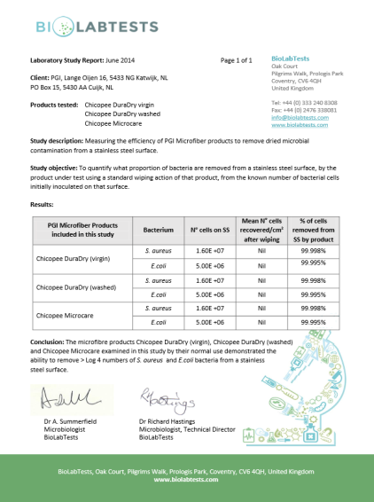
Removes 99,998% of microbes from the surface
BUT remember: it does not kill bacteria
What does this mean?
Depending on the level of cleaning required for the task will depend on the strength of the chemical used with the cloth
What are microbes?
A microorganism, especially a bacteria causing disease or fermentation, also includes virus’ and germs
Why is it important?
Microfibre cloths are not all equal, some contain less than 25% of Microfibre
If not washed at the correct temperature and with the correct chemicals, microbes could remain on the cloth after laundry

Slide 11
Removes & TRAPS microbes in the cloth
Splittable microfibre is an effective cleaning tool because the fibers are positively charged. Bacteria, dirt and dust are negatively charged so they are attracted to microfibre like a magnet.
The microfibre holds on to bacteria, dust and dirt until it is released. (capillary effect)
Contaminated surface cleaned with new cloth using water only
The same cloth is then used to clean a second surface that has no contamination
% of Cross-contamination from used cloth onto uncontaminated surface*
Splittable Microfibre | 0%
Traditional cotton cloth | 36.2%
*Scott E, Bloomfield SF. The survival and transfer of microbial contamination via cloths, hand and utensils. J. Appl. Bacteriol. 1990;68:271-8

Slide 12
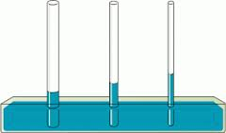
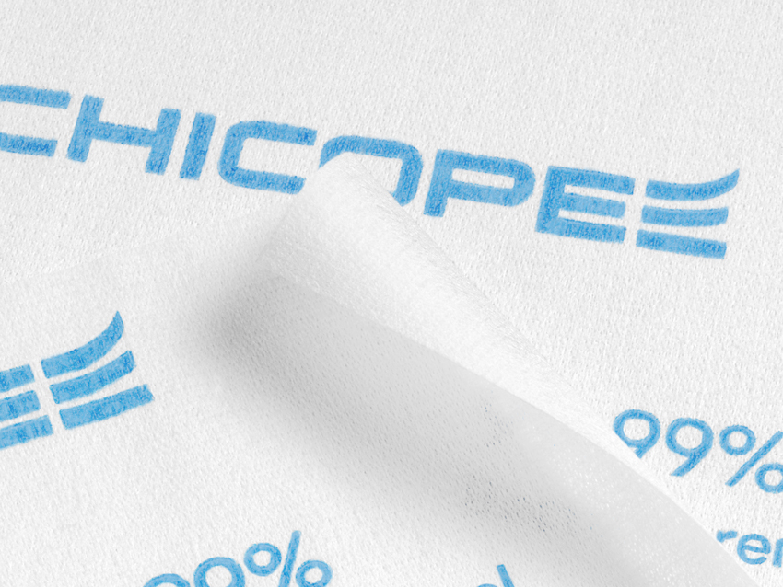
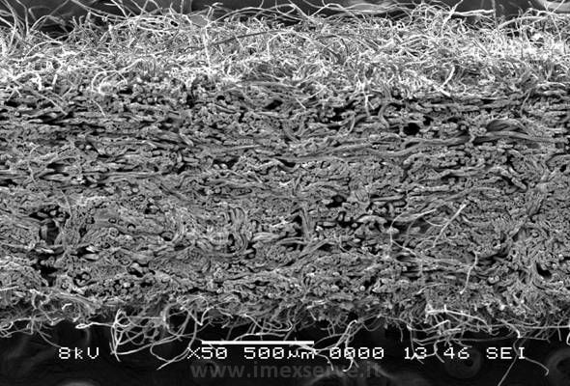
Capillary effect of microfibre
Capillary activity improves with Microfibre!
Increased capillary action of microfibre
Nature of PET/PA
Positively charged; attracts dust (negatively charged)
PA is lipophilic; ‘fat-liking’

Slide 13
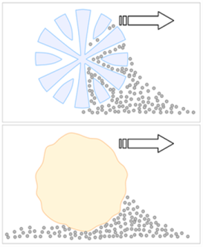
How? I don’t believe you!
String Mop Human Hair Split microfibre
Hook feature
(1/100th of a human hair)
Mechanical cleaning is a powerful and still developing concept that we have to understand and explain well to end users
Splittable microfibre at work
Traditional cloth at work
A normal cotton cloth just moves the bacteria and dirt around where a splittable microfibre removes them from the surface.
1.
2.

Slide 14
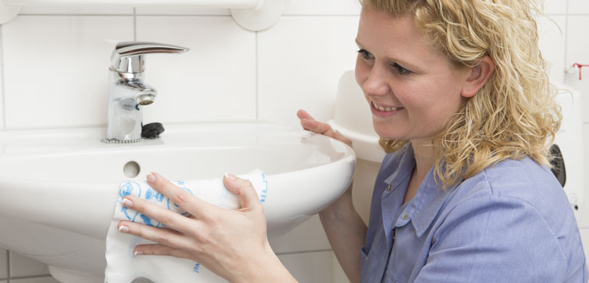
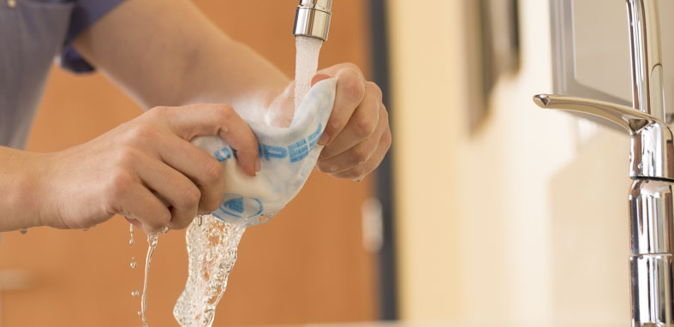
Improved hygiene and reduced labour time
Best Cleaning results
Mechanical cleaning
Streak-free wiping
Low linting
Best Hygiene
4 99.99% Bacteria removal
5 Cleans without chemicals
6 Short term usage
Best Cost
7 No laundry facility needed
8 Reduces HAI’s & CAI’s
9 Reduce labour time
Chicopee microfibre cloth -- light

Slide 15
Tested product performance
Benchmark test vs leading competitor products
Method | Test | Chicopee Microfibre Light | Competitor product 1 | Results in…..
Test No | Description | 34x40 cm, White | 20.5x39.5cm, White
TM 1150 gr/m2 | Gsm | 60 | 71
WTM 018 mm/4ply | Thickness | 1.42 | 0.94 | >50% Bulkier
WTM 015 Secs | Absorbency Speed | 2.6 | 18.1 | 7x Quicker absorption
WTM 015 % | Absorbency Capacity | 928 | 733 | 25% More abs capacity
WTM 017 1ply | Strength (MD&CD) | 166 | 136 | 22% Stronger Dry
WTM 017 1ply | Wet Strength (MD&CD) | 146 | 129 | 13% Stronger Wet
Notes:
It was the Vileda microlite 60 blue. (white fabric with blue stripes for color coding) The GB product code for a pack is 141203.
Only the size of the Vileda wipe is wrong. Specification on the website mention 40x30 cm.

Slide 16
Where to sell
Healthcare
Proven results in use
Facility management
Great Cost-Out story
Trials on-going at 2 locations to develop a cost comparison calculator

Slide 17
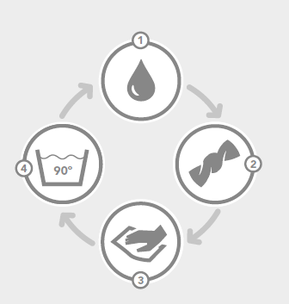
How to use
Wet the cloth with water
Wring out the cloth to leave it damp
Use the cloth on any surface that needs cleaning
Throw the towel away or rinse and re-use again
Suggested usage
Use damp and folded twice, to maximize the cleaning performance
After 2- 4 hours of use replace the cloth with a new one
Compatible with all leading chemicals
Cloth could be incinerated with the hospitals incineration system after contamination.

Slide 18
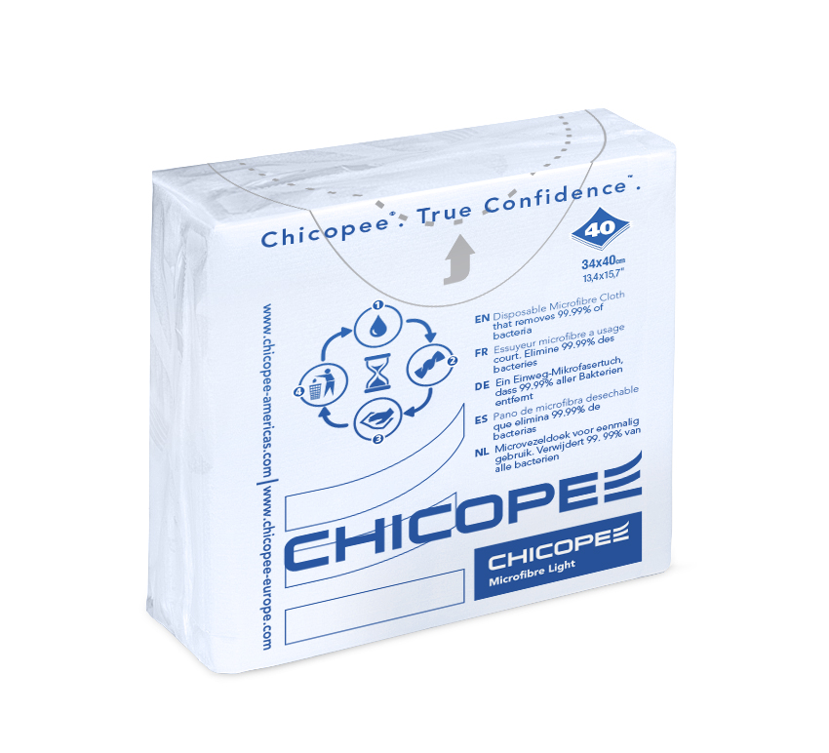
Microfibre cloth – light packaging
Packaging is re-sealable
This means you can take x1 wipe and re-seal the pack for maximum hygiene
This is unique in the market for short term use microfibre
Don’t leave any thing to chance!

Slide 19
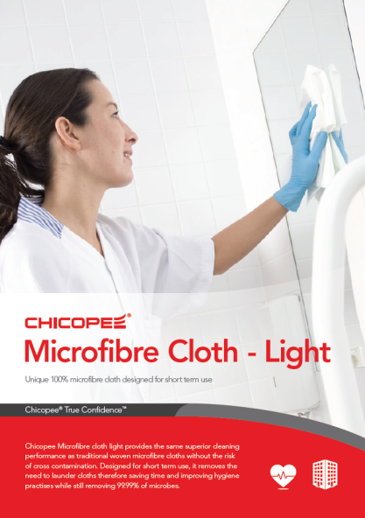
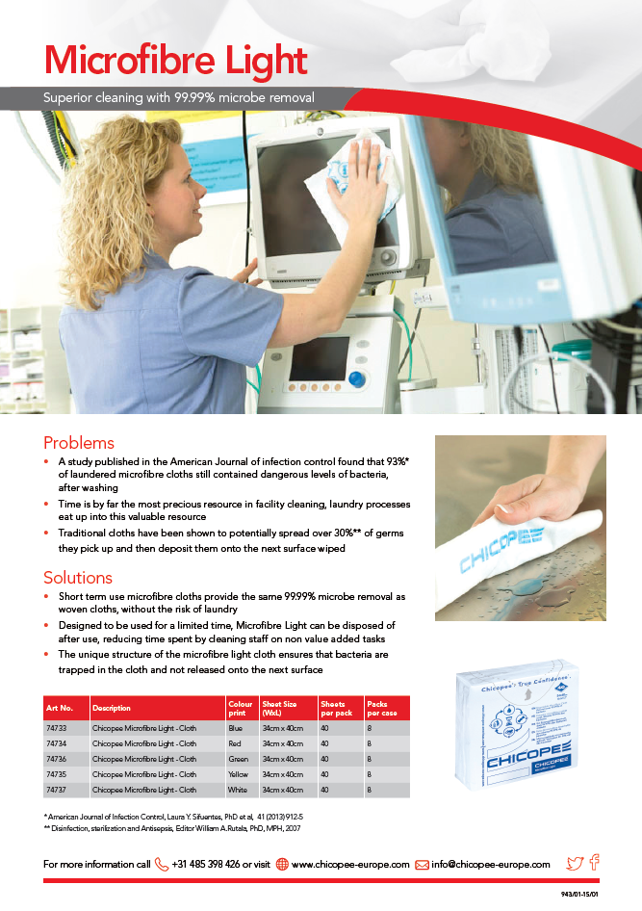
Product information sheet

Slide 20
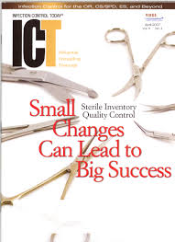
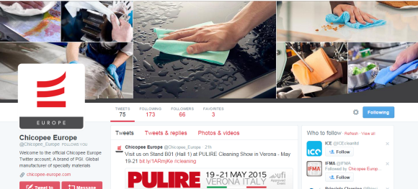
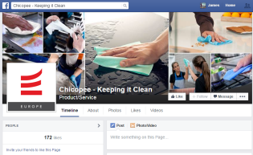
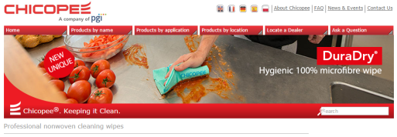
P.R. and Media
Exposure across all new media platforms, online and printed media across EU

Slide 21
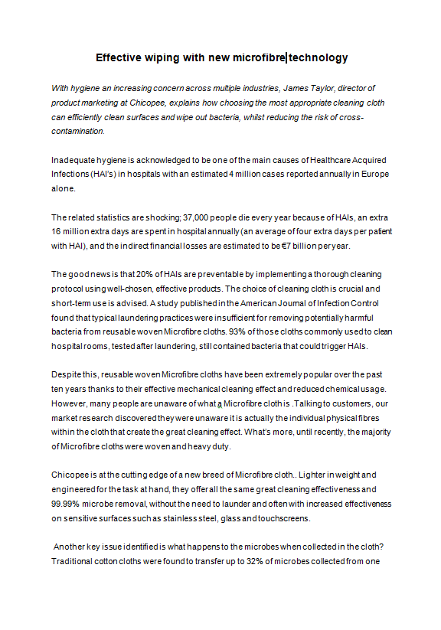
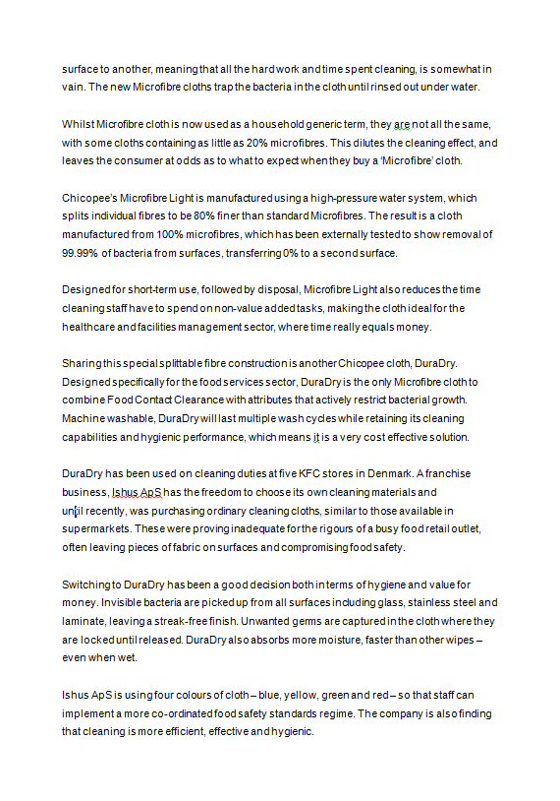
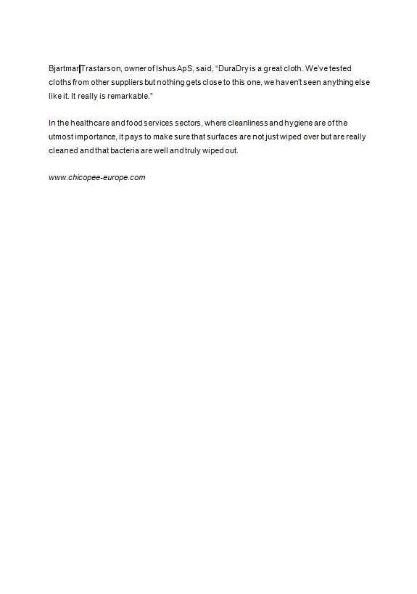
Microfibre PR Story

Slide 22
Advertising & promotion support
Free sample packs available to support key customer activity
Provocative advertising used
Designed to provoke a response and ensure end users understand the issues with current ways of cleaning, and solutions to these
Will be used to support exhibitions and in specific journals and magazines

Slide 23
Chicopee microfibre cloth – light SKU’s
Product Information
Product code | 7473700 | 7473300 | 7473400 | 7473500 | 7473600
Description | Chicopee Microfibre Light | Chicopee Microfibre Light | Chicopee Microfibre Light | Chicopee Microfibre Light | Chicopee Microfibre Light
Sheet Size | 34 * 40cm | 34 * 40cm | 34 * 40cm | 34 * 40cm | 34 * 40cm
Weight | 60 gsm | 60 gsm | 60 gsm | 60 gsm | 60 gsm
Colour | White | Blue | Red | Yellow | Green
Sheets/pack | 40 | 40 | 40 | 40 | 40
packs/Case | 8 | 8 | 8 | 8 | 8
Pallet | 42 cases | 42 cases | 42 cases | 42 cases | 42 cases
Stock item | Yes | Yes | Yes | Yes | Yes
# on stock | 2 pallets | 4 pallets | 0 | 0 | 0
Launch date | 1st April 2015 | 1st April 2015 | Mid June 2015 | Mid June 2015 | Mid June 2015

Slide 24
Case Specifications
Layers pallet: 7
Cases per layer: 6
Cases per pallet: 42
Gross weight case 3,6595 KG
Net weight case: 2,6342 KG
Case size: 390X340X230MM (L x W x H)
UPC-unit bar code:
CPC-case bar code: Not used

Slide 25
Thank you!

Slide 26
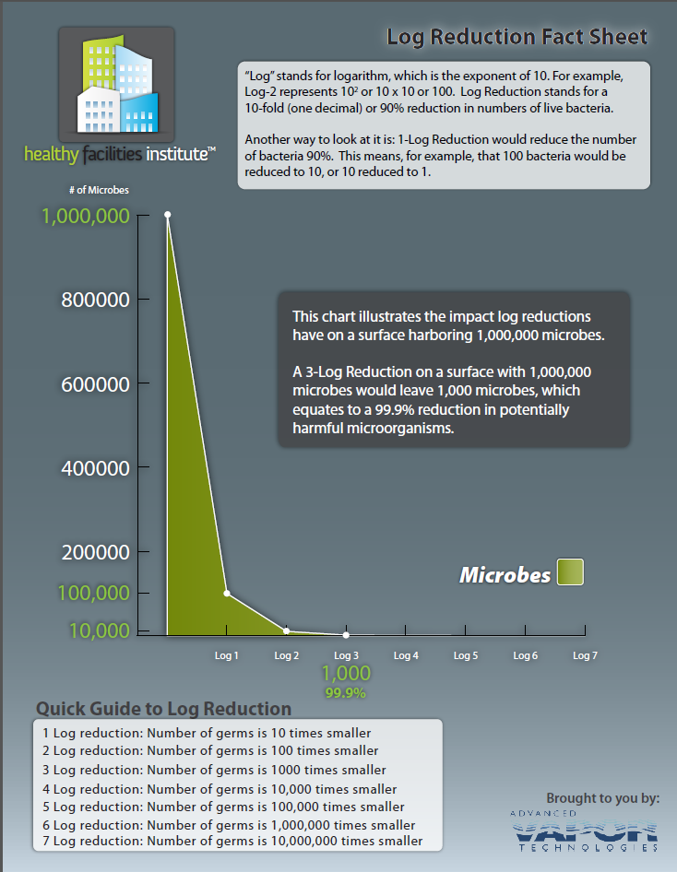
Chicopee Microfibre Light
Removes 99.99% Microbes
Log 4 reduction of microbes
x10 times more than log 3 (99.9%)

Slide 27
More than just wiping…
Step 1.
Identify “dirt removal” needs
Detergent
Cleaning- Dry
Wiping
Sanitizing
Disinfecting
Fine Particulate / Microbe Removal
Large Debris or Contaminant Removal
Step 2.
Choose cleaning level required
Step 3.
Choose cleaning system
Surfaces & Objects
Soak a dry wipe in chemical
Wipe with a pre-moistened wipe
Spray chemical and wipe dry with a wipe
Level of efficacy

